Slide 1


Slide 2
CBM Block Reserve Estimation using ECLIPSE

Slide 3
Objectives:-
Reserve calculation of CBM block using case study and comparative analysis of properties.
Learning the basics of ECLIPSE for CBM simulation.
Learning the basics of CBM block and its extraction process.

Slide 4
What is Coal Bed Methane??
Standard natural gas- CH4
Methane forms along with coal
during coalification process.
Held in the cleats with the coal.
Held on the surface of the coal
matrix by adsorption.

Slide 5
Vitality of CBM Gas Extraction
Energy need of the nation is increasing at exponential rate.
Alternative and non-conventional sources of energy are becoming indispensable.
CBM is a clean burning fuel.
Improves safety of coal mining and prevents firedamp explosion.
Provides a means to use the abundant coal resource that is too deep to mine.
Decrease methane vented to the atmosphere which might cause global warming.
An unexplored source of energy which has great economic potential.

Slide 6
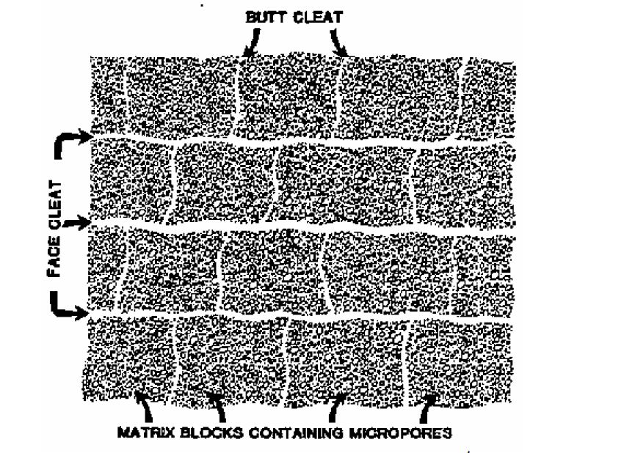
CBM and its Dual Porosity

Slide 7
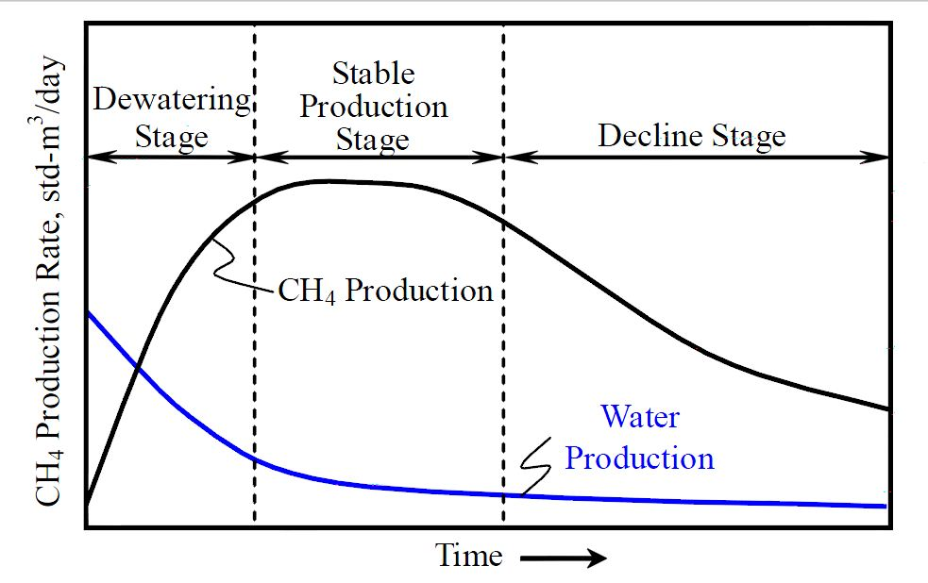
Production Profile of a CBM well

Slide 8
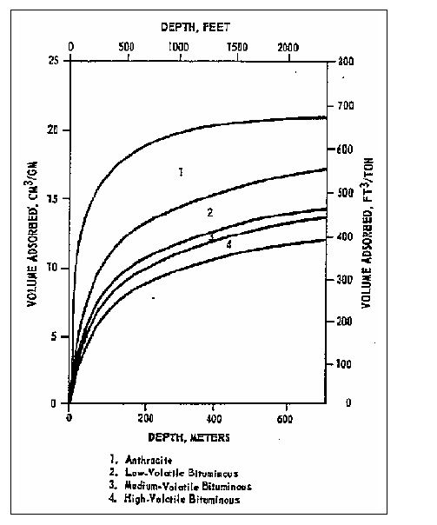
Relationship Between Rank, Depth and Sorptive Capacity of CBM

Slide 9
Different Simulator used in the Industry
COMETPC 3-D
It is used to perform three different types of coal bed methane reservoir simulation studies.
GEM
It is by the Computer Modeling Group (CMG) Ltd., and is a compositional reservoir simulator using a dual porosity system, adsorption, diffusion and additional features for modeling CBM reservoirs.
For modeling the diffusion process, GEM uses sorption time, τ, as a direct input.
ECLIPSE
It is available from Schlumberger.
For CBM modeling, this simulator uses a dual porosity system applying adsorption, diffusion and additional features.

Slide 10
“ECLIPSE” Simulator Basic Description
Oil and gas reservoir simulator developed by ECL
( Explorations Consultants Limited) and owned by Schlumberger.
ECLIPSE is an acronym for ECL’s Implicit Program for Simulation Engineering.
It uses finite volume method to solve material and energy balance equations modeling a subsurface reservoir.

Slide 11
Data Requirement for CBM Simulation
Reservoir description data such as geometry, structure, net thickness, depth, stratification, initial water saturation and pressure.
Fluid PVT data such as gas viscosity and composition and time dependent well data such as fluid rates and bottom hole pressure.
Absolute cleat permeability which determines rate of gas recovery, initial gas content for determining gas in place, adsorption isotherm for determining ultimate gas recovery and cleat porosity which is site of water storage in coal beds and determines volume of water produced.

Slide 12
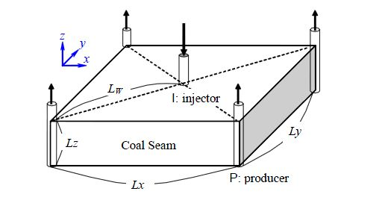
Case Study
A coal seam at Raniganj mine was selected and simulation was done using ECLIPSE simulator.
Study was done for a coal seam of approximately “22” acre area.
Five-spots pattern was built using the ECLIPSE.
Grid sensitivity study used a single layer grid model of 75×75×1 in a 5-spots pattern with the dimensions of the coal reservoir 1000×1000×3.64 ft.

Slide 13
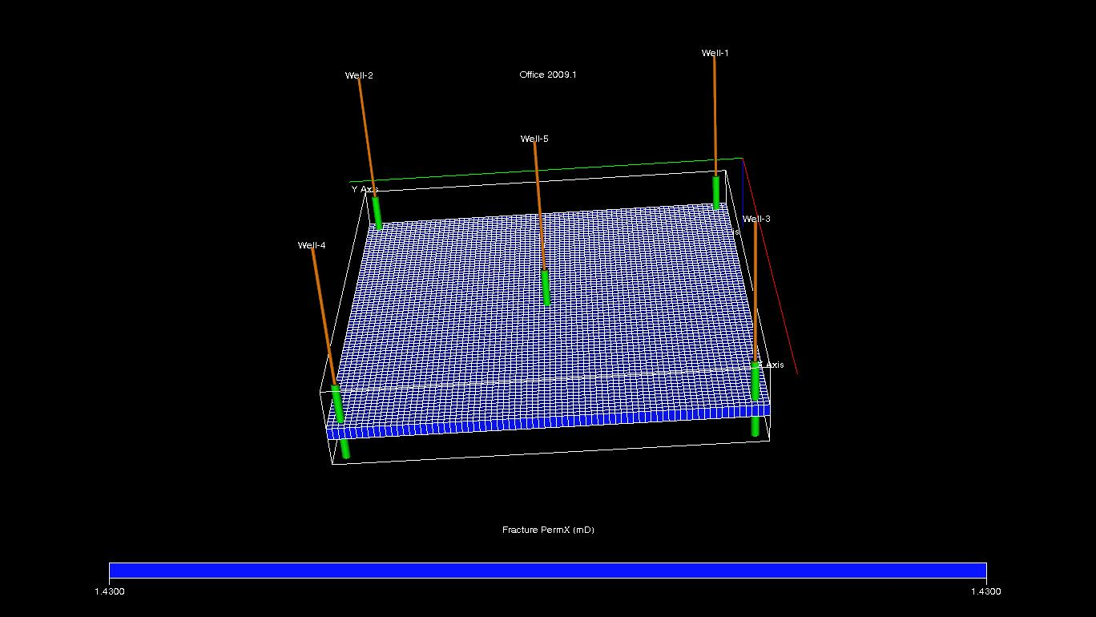
Model Geometry of 5-point model

Slide 14
Input Data for ECLIPSE Model
Parameter | Unit | Values
Reservoir drainage area | ft² | 10⁶
Depth | ft. | 3050
Reservoir thickness | ft. | 3.64
Coal- seam porosity | % | 2.67
Absolute permeability | md | 1.43
Initial pressure | Psia | 1392
Rock density | g/cc | 1.4172
Sorption time Constant | days | 7
Microbe Diffusion Coefficient | ft² /day | 1

Slide 15
Input Data for ECLIPSE Model
Parameter | Unit | Values
Sorption Volume(CH₄) | scf/ton | 578
Sorption Pressure (CH₄) | Psia | 611
Initial water saturation | % | 100
Initial mole fraction of gas(CH₄) | % | 100
Reservoir Temperature | F | 113
Well bottom Hole Pressure | Psia | 40
Well bore Radius | ft. | 0.5 ft.
Ash Content | % | 19
Moisture Content | % | 8
Abandonment Pressure | Psia | 20

Slide 16
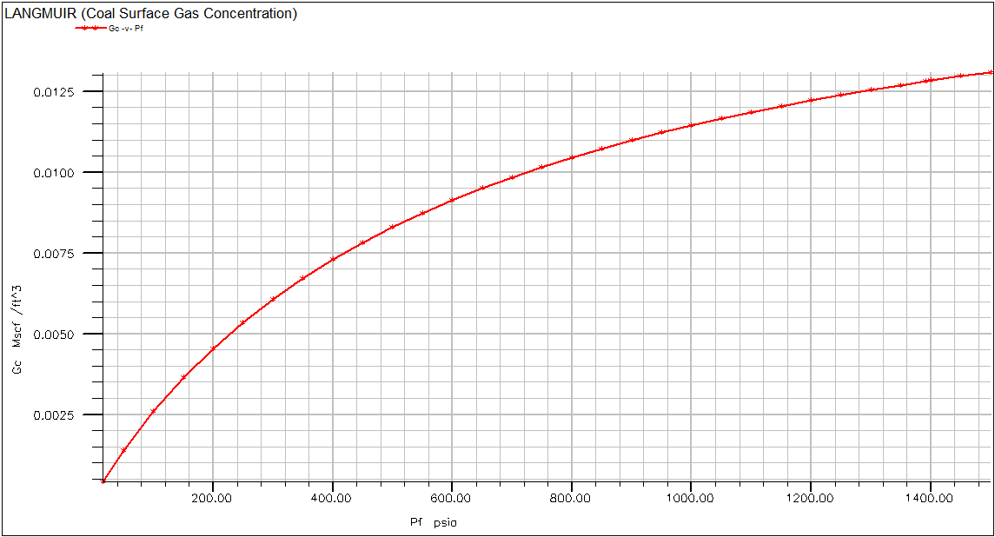
Desorption Isotherm for CH4

Slide 17
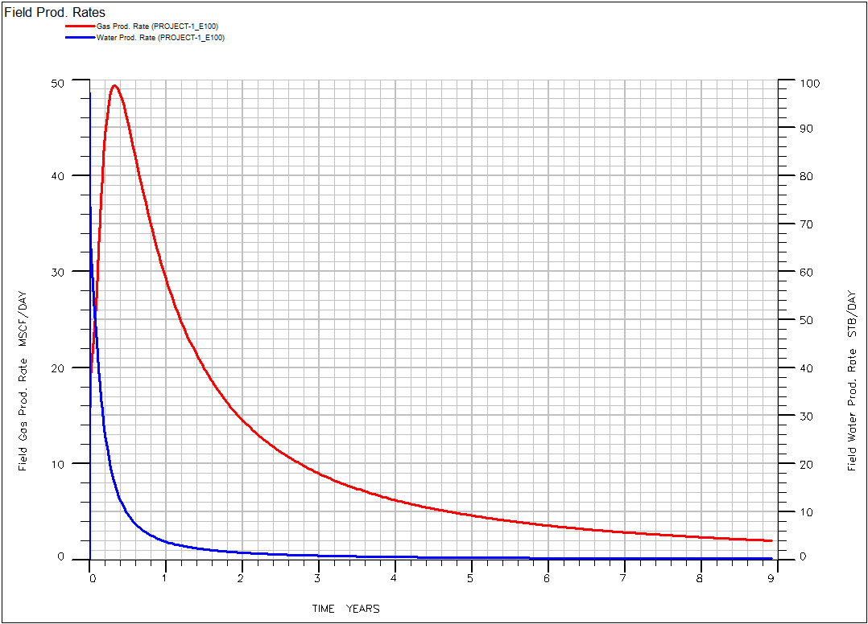
Flow rate v/s Time for Primary Recovery

Slide 18
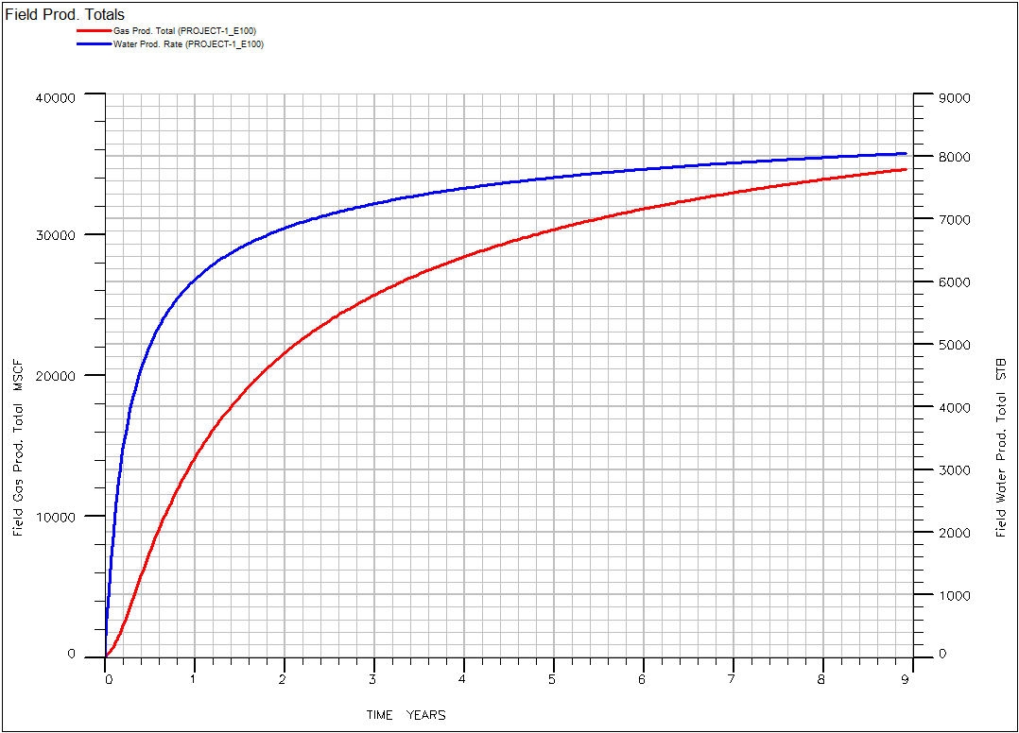
Total production v/s Time for Primary Recovery

Slide 19
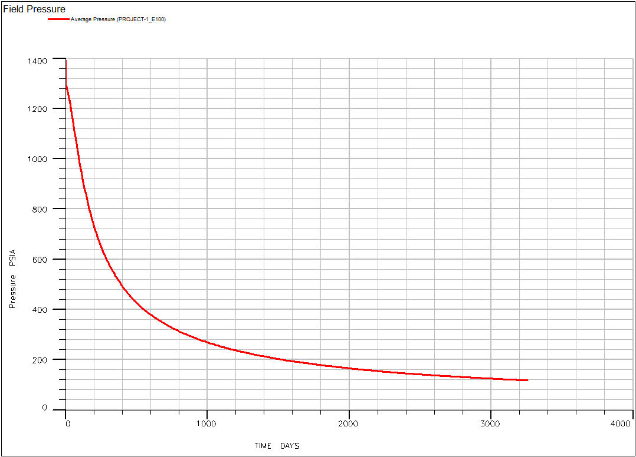
Avg. Pressure Profile

Slide 20
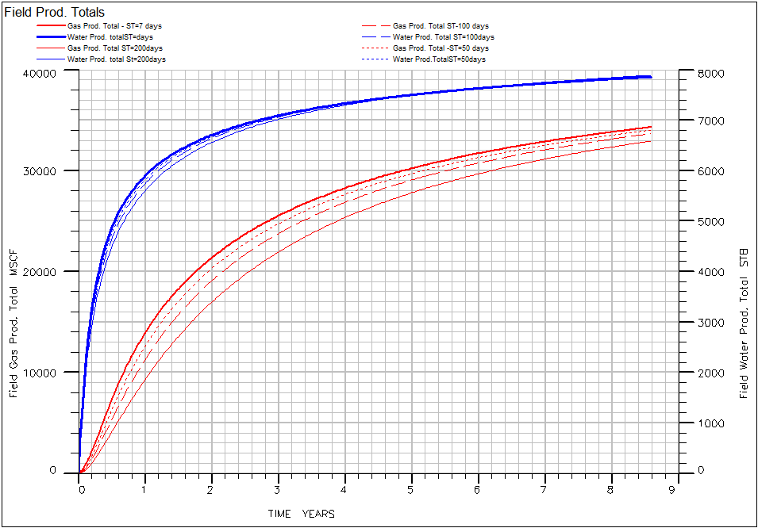
Total Field Production Comparison for Different Sorption Time

Slide 21
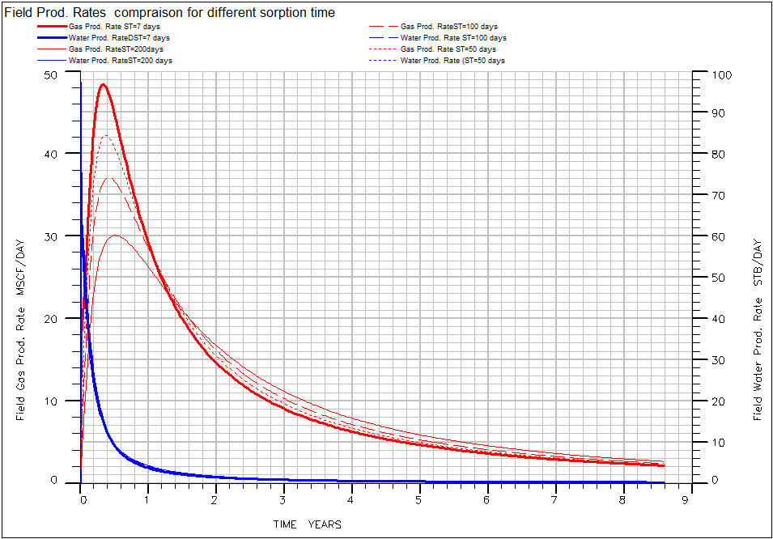
Field Production Rate for Different Sorption Time

Slide 22
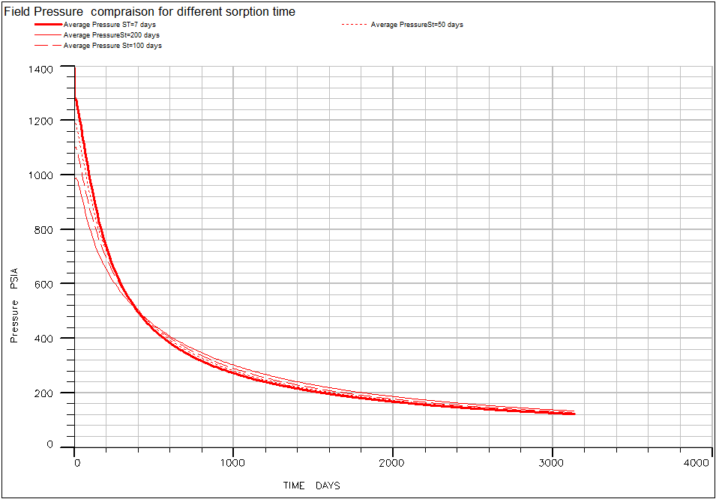
Field Pressure Profile for Different Sorption Time

Slide 23
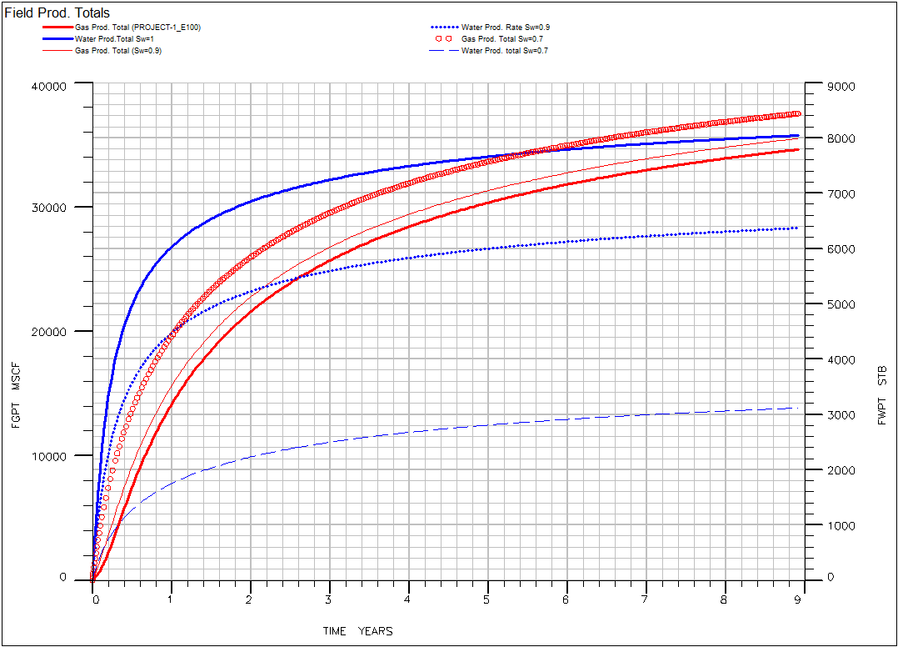
Field Production Total for Different Initial Water Saturation

Slide 24
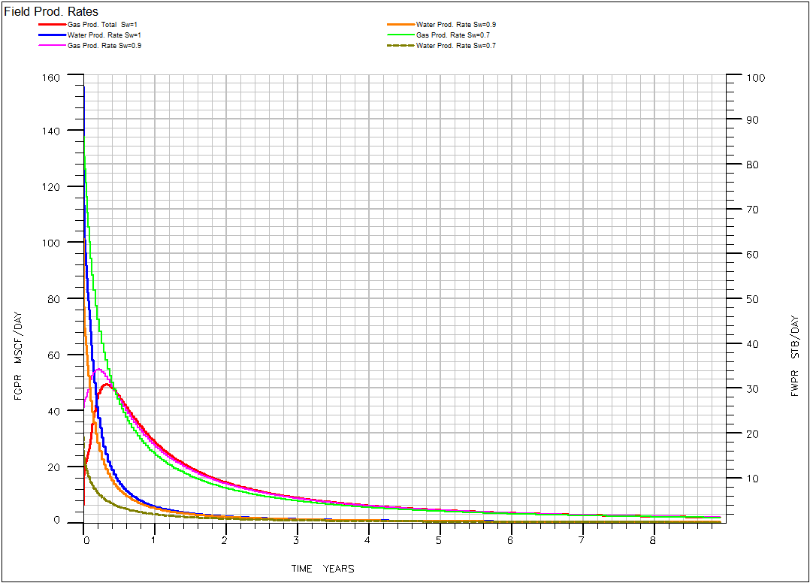
Field Production Rate for Different Initial Water Saturation

Slide 25
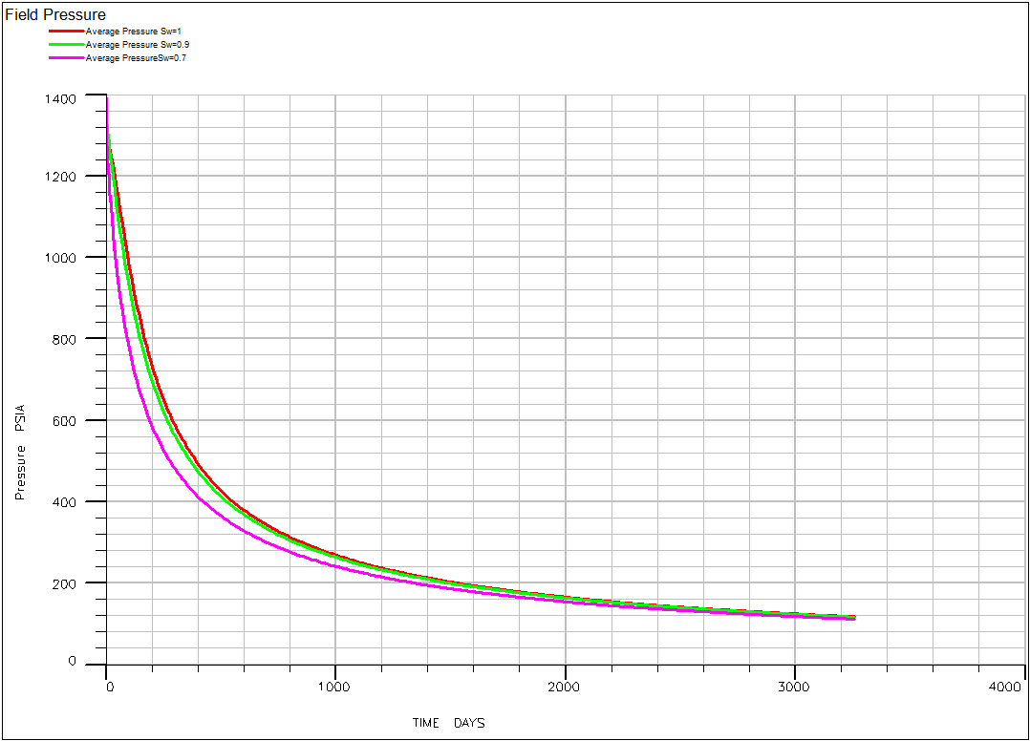
Field Pressure Profile for Different Initial Water Saturation

Slide 26
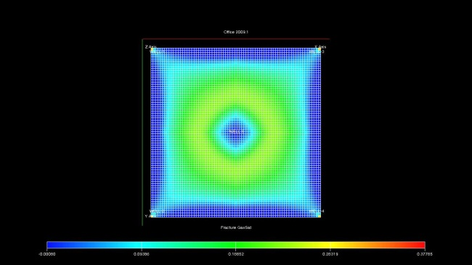
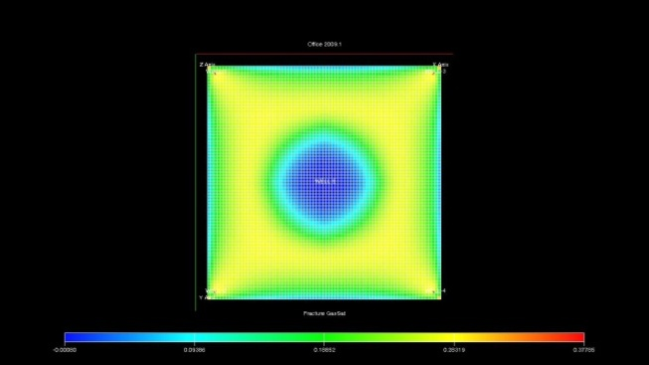
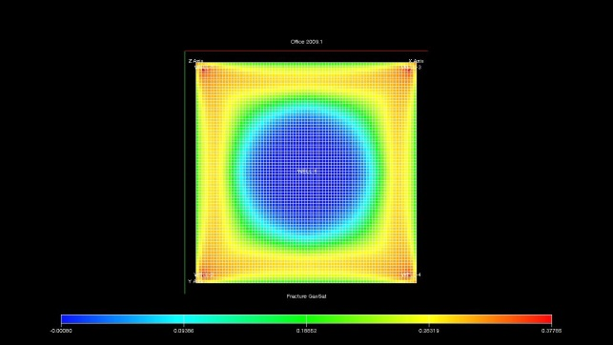
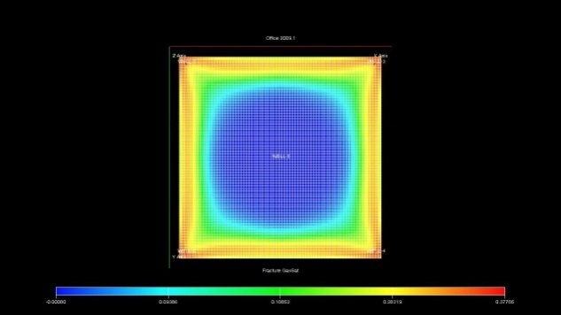
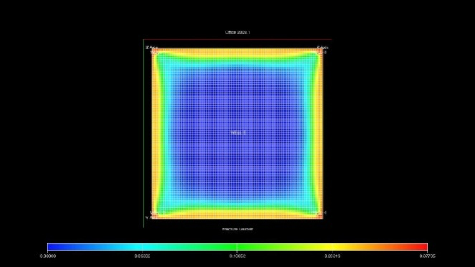
CH4 Gas Saturation after 1,3,6,9 and 12 months

Slide 27
Results and Conclusions
Total gas content in the coal seam block is 57108847 scf over an area of 10⁶ sq.ft. The recovery factor for the block is 95.43% for primary recovery process.
Higher saturation of water in coal seam extends the time require to produce the methane gas and a sufficient length of dewatering period will be required before production of gas.
Sensitivity of production profile indicates that by applying erroneous formulation for sorption time an incorrect production profile and gas peak will be estimated. So reservoir simulator which include diffusion for modelling reservoirs instead of combining desorption isotherm and equation of conventional reservoir will correctly model the production profile.

Slide 28
Future Scope of Project
The project has great scope in calculation of CBM potential in number of CBM field being developed by Govt. Of India.
ECLIPSE as a software has been highly successful in getting correct reserve estimation and sensitivity analysis and thus could be used extensively in the industry.
Comparative analysis of gas rate, total production of CBM et. al. with sorption time, initial water saturation has proved out to be of great importance in selecting the block for CBM extraction.

Slide 29
References
Zuber, M.D. et al.: “The Use of Simulation and History Matching to Determine Critical Coalbed Methane Reservoir Properties,” paper SPE/DOE 16420 presented at the 1987 SPE/DOE Low Permeability Reservoir Symposium, Denver, and 18-19 May.
Seidle, J.P., and Arri, L.E.: “Use of Conventional Reservoir Models for Coalbed Methane Simulation,” paper CIM-90/SPE 21599 presented at the 1990 International Technical Meeting, Calgary, 10-13 June.
“Comparison of Computation Methods for CBM Performance”, C.A. MORA, R.A. WATTENBARGER Texas A&M University & S. MCKETTA El Paso Exploration and Production Company, 8th Canadian International Petroleum Conference (58th Annual Technical Meeting), Calgary, Alberta, Canada, June 12 – 14, 2007
Jalal, J. and Shahab, D.M.: “A Coalbed Methane Reservoir Simulator Designed for the Independent Producers,” paper SPE 91414 presented at the 2004 SPE Eastern Regional Meeting, Charleston, West Virginia, 15-17 September.
Halliburton handbook : “ Coalbed methane potential (principle and practice) ”.

Slide 30
THANK YOU

Slide 32


Back Up Slide
Gas in Place Estimation
CBM models are characterized as a coal/cleat system of equations. Most of the gas is stored in the coal blocks. Gas storage is dominated by adsorption according to Eq.3.3.1
Gas concentration, Gc, is a function of the Langmuir Isotherm curve by means of Eq.3.3.2
Langmuir volume (V_{L}) represents the maximum amount of methane adsorbed on the surface of the coal matrix when the pressure, P, reaches infinity. This value is asymptotically approached by the isotherm (Fig. 1.3) as the pressure increases.
Langmuir pressure (P_{L}) represents the pressure where the amount of adsorbed methane is one half of its maximum amount, V_{L}.
For most of the reservoirs, the coal cleats are initially water saturated. However, some reservoirs present free gas in the cleat system, and in some special cases, there is no water in the cleat system (dry coal). Most of the times, the free gas in the cleat system volume is very small compared with the gas adsorbed on the surface of the matrix. Gas in Place in the cleat system is estimated using the volumetric Eq. 3.3.3.
GIPf = A * h* f * (1-Sw ) / bg…….. ………………………………………............. 3.3.3
So, the total gas in place is the sum of the adsorbed gas in the matrix system and the
free gas in the cleats as is shown in Eq. 3.3.4
GIP = GIPs + GIPf

Slide 33
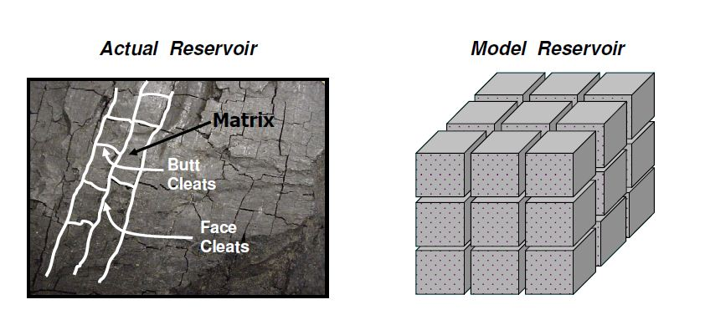
Actual and Model CBM Reservoir

Slide 34
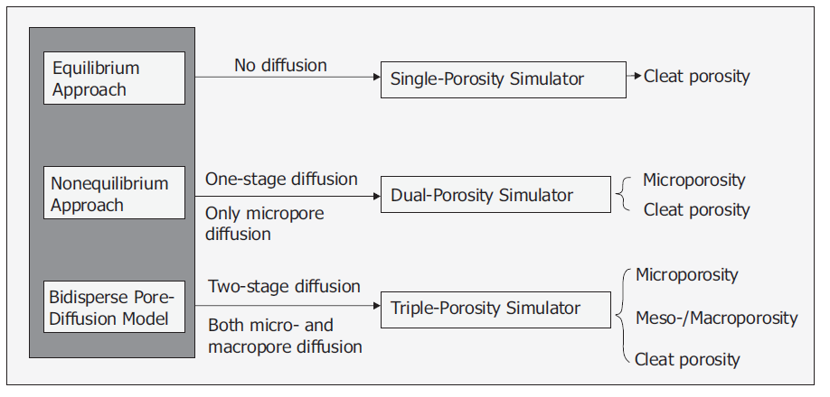
Comparison of different diffusion model applied to Coal Bed Methane Reservoir

Slide 35


Sorption Time for Modelling Diffusion Process
The drainage rate (Fick’s Law) from the coal block can be expressed using Eq.
Sorption time, express the diffusion process by means
of Eq.
By definition, , is the time at which 63.2% of the ultimate drainage occurs when maintained at constant surrounding pressure and temperature.
From laboratory tests (canister test) the diffusivity term can be estimated and therefrom the sorption time can be calculated.

